Slide 1
19Z701 - CRYPTOGRAPHY

Slide 2
19Z701 CRYPTOGRAPHY
COMPUTER SECURITY CONCEPTS : The OSI Security Architecture - Security Attacks - Security Services – Security Mechanisms - A Model for Network Security - Number Theory Concepts: Fermat‘s and Euler‘s Theorems, Euclidean Algorithm - Classical Encryption Techniques (5 + 4)
SYMMETRIC CIPHERS : Block Ciphers and Stream Ciphers - Random Bit Generation and Stream Ciphers: Principles of Pseudorandom Number Generation - Pseudorandom Number Generators:Linear Congruential Generators - Block Cipher Modes - Data Encryption Standard (6 + 6)
PUBLIC-KEY CRYPTOGRAPHY : Principles of Public Key Cryptosystems - The RSA Algorithm - Diffie-Hellman Key Exchange - Elliptic Curve Cryptography (5 + 5)
CRYPTOGRAPHIC HASH FUNCTIONS : Secure Hash Algorithm (SHA) - Message Authentication Codes – Message Authentication Requirements - Message Authentication Functions - Digital Signatures - Digital Signature Standard (DSS) - Blockchain: The growth of blockchain technology - Types, Consensus, and Mining Task - Platforms. (6 + 8)
ROLE OF CRYPTOGRAPHY IN SECURITY PROTOCOLS : Network and Internet Security Protocols: Transport-Level Security -Secure Sockets Layer (SSL) - Email Security: Pretty Good Privacy (PGP) - Firewalls: Characteristics and Types (8 + 7) Total L: 30 +T: 30 = 60

Slide 3
TEXT BOOKS:
1. Hans, Knebl, Helmut, Delfs , "Introduction To Cryptography Principles And Applications", 3rd Edition, Springer- Verlag, Berlin Heidelberg, 2015.
2. William Stallings , "Cryptography and Network Security: Principles and Practice", 7th Edition, Prentice Hall of India, Pearson Education, New Delhi, 2017.
REFERENCES:
1. Behrouz A Forouzan , "Cryptography and Network Security", 3rd Edition, Tata McGraw Hill Ltd, New Delhi, 2015.
2. Atul Kahate , ", Cryptography and Network Security", 3rd Edition, Tata McGraw Hill Ltd, New Delhi, 2013.
3. Imran Bashir , "Mastering Blockchain: Distributed Ledger Technology, Decentralization, and Smart Contracts Explained", 7th Edition, Packt Publishing Ltd, 2018.
4. Douglas Robert Stinson, Maura Paterson , "Cryptography: Theory and Practice", 4th Edition, Chapman and Hall/CRC, 2018.

Slide 4
Course outcomes
CO1: Understand security threats, services, mechanisms and Techniques and illustrate the working of classical ciphers
CO2: Apply number theory concepts for solving symmetric and asymmetric cryptographic techniques.
CO3: Illustrate the working of asymmetric cryptographic techniques and working of cryptographic hash functions.
CO4: Describe Message authentication codes, key management and Blockchain
CO5: Explain user authentication protocols, and Network Security protocols

Slide 5
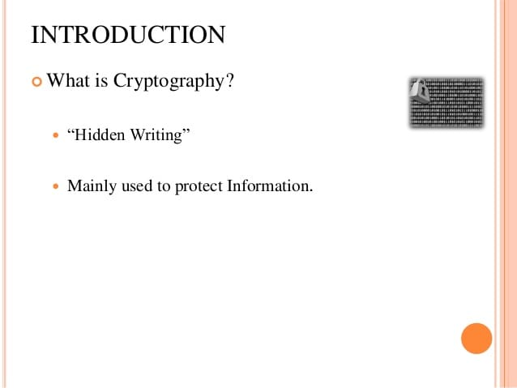

Slide 6
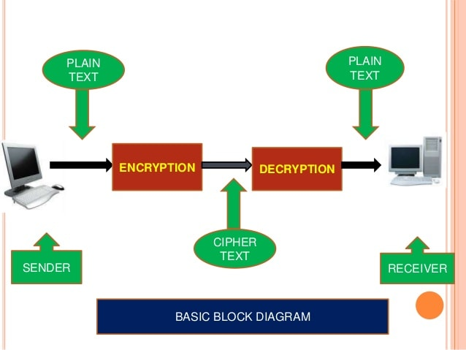

Slide 7
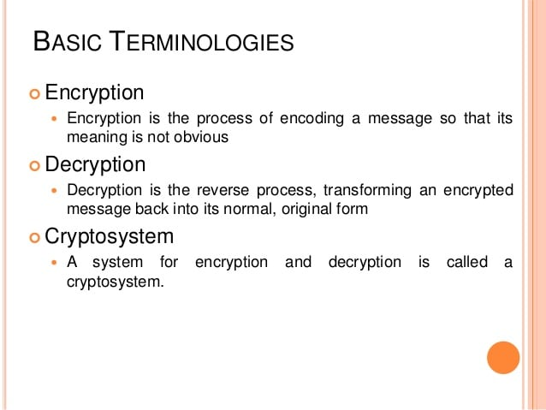

Slide 8
Some Basic Terminology
plaintext - original message
ciphertext - coded message
cipher - algorithm for transforming plaintext to ciphertext
key - info used in cipher known only to sender/receiver
encipher (encrypt) - converting plaintext to ciphertext
decipher (decrypt) - recovering ciphertext from plaintext
cryptography - study of encryption principles/methods
cryptanalysis (codebreaking) - study of principles/ methods of deciphering ciphertext without knowing key
cryptology - field of both cryptography and cryptanalysis

Slide 9


Symmetric Cipher Model

Slide 10
Requirements
two requirements for secure use of symmetric encryption:
  a strong encryption algorithm
  a secret key known only to sender / receiver
mathematically have:
  Y = E_{K}(X)
  X = D_{K}(Y)
assume encryption algorithm is known
implies a secure channel to distribute key

Slide 11
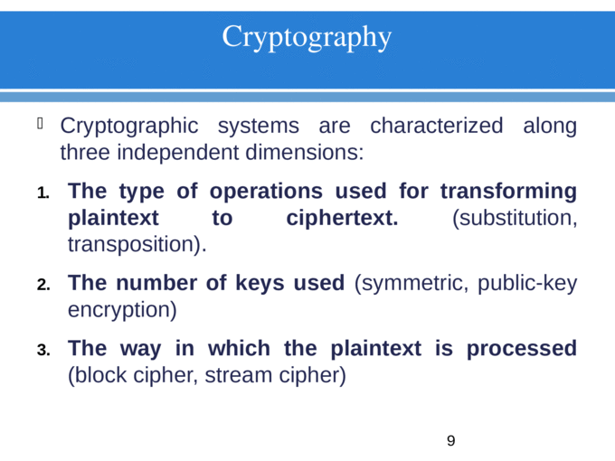

Slide 12
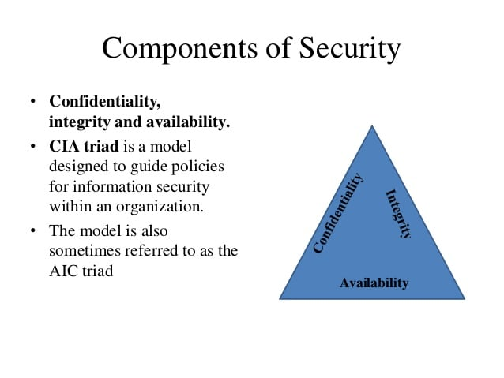

Slide 13
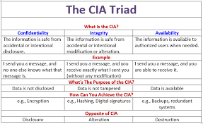

Slide 14
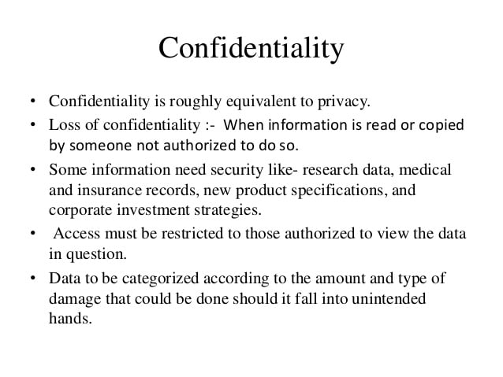

Slide 15
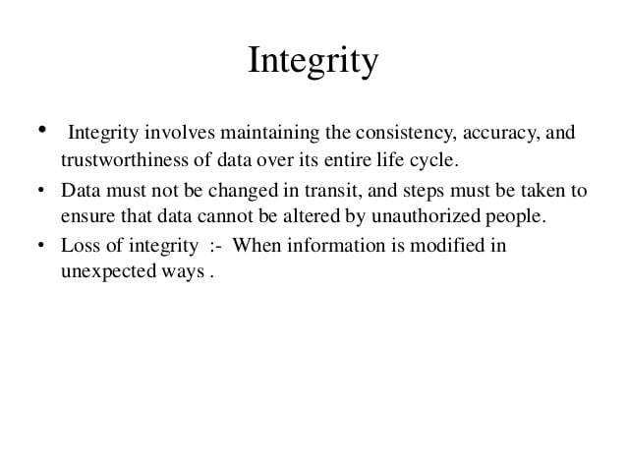

Slide 16
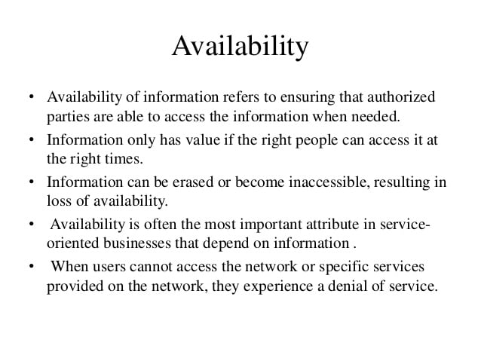

Slide 17
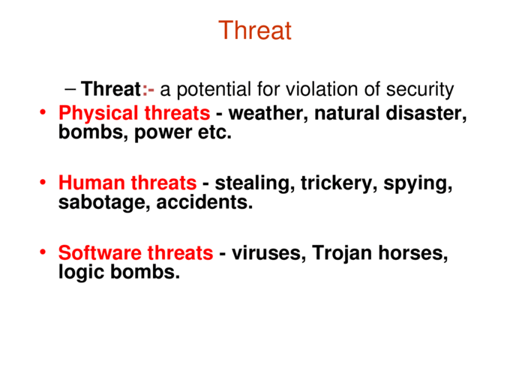

Slide 18
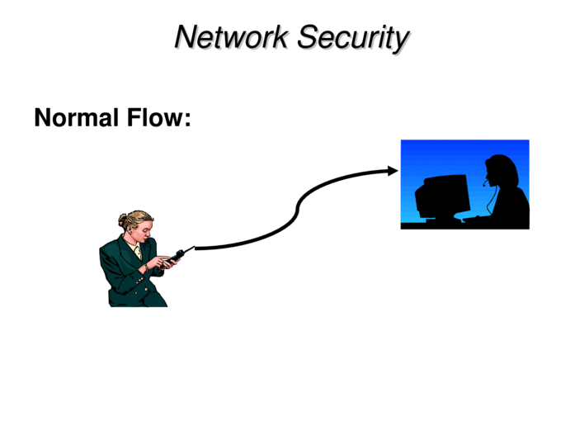

Slide 19
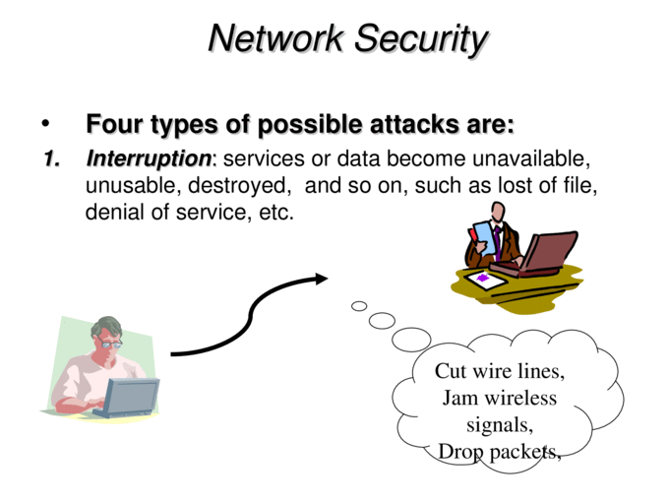

Slide 20
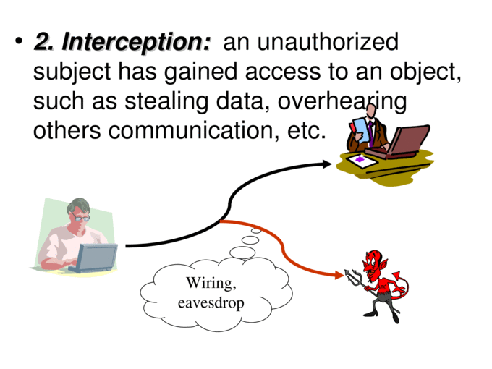

Slide 21
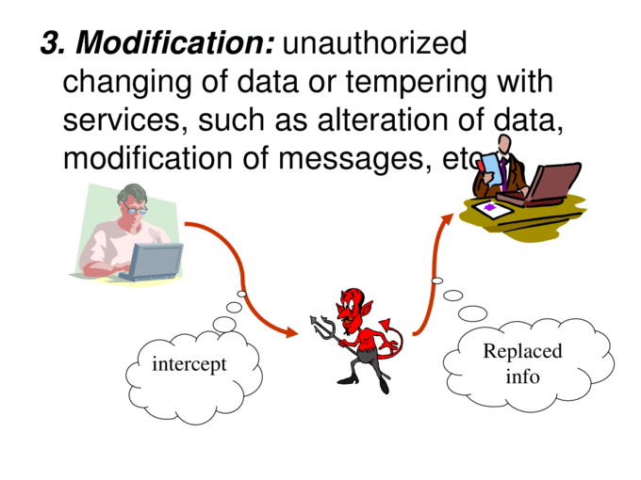

Slide 22
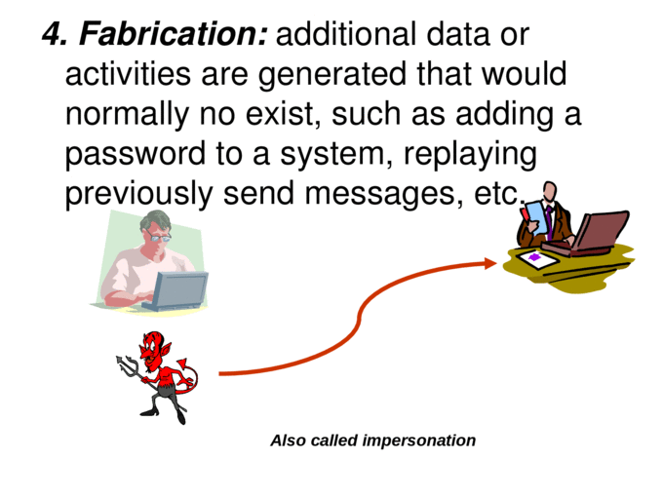

Slide 23
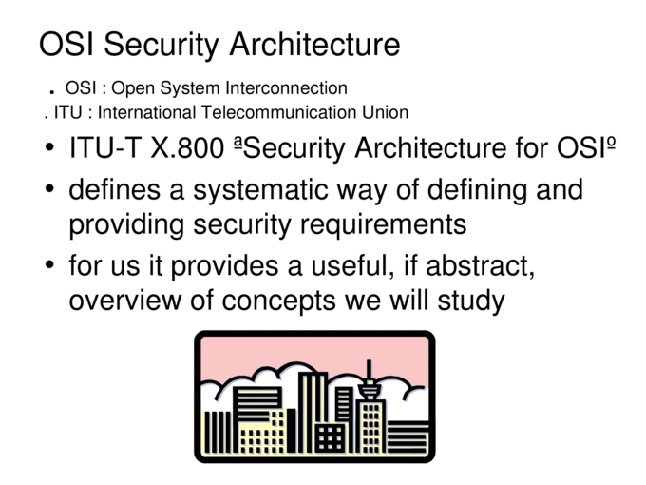

Slide 24
Aspects of Security
consider 3 aspects of information security:
  security attack
  security mechanism
  security service

Slide 25
Security Attack
any action that compromises the security of information owned by an organization
information security is about how to prevent attacks, or failing that, to detect attacks on information-based systems
often threat & attack used to mean same thing
have a wide range of attacks
can focus of generic types of attacks
  passive
  active

Slide 26

Passive Attacks

Slide 27
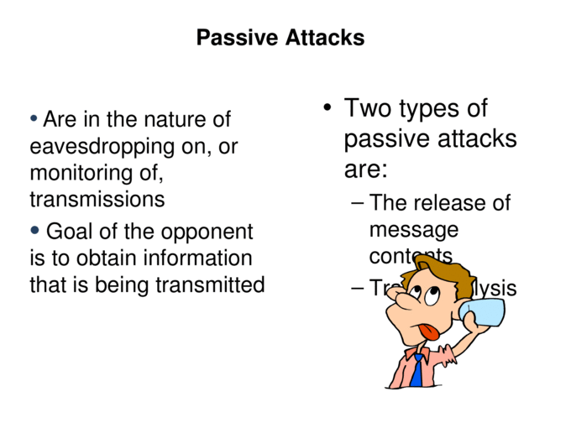

Slide 28
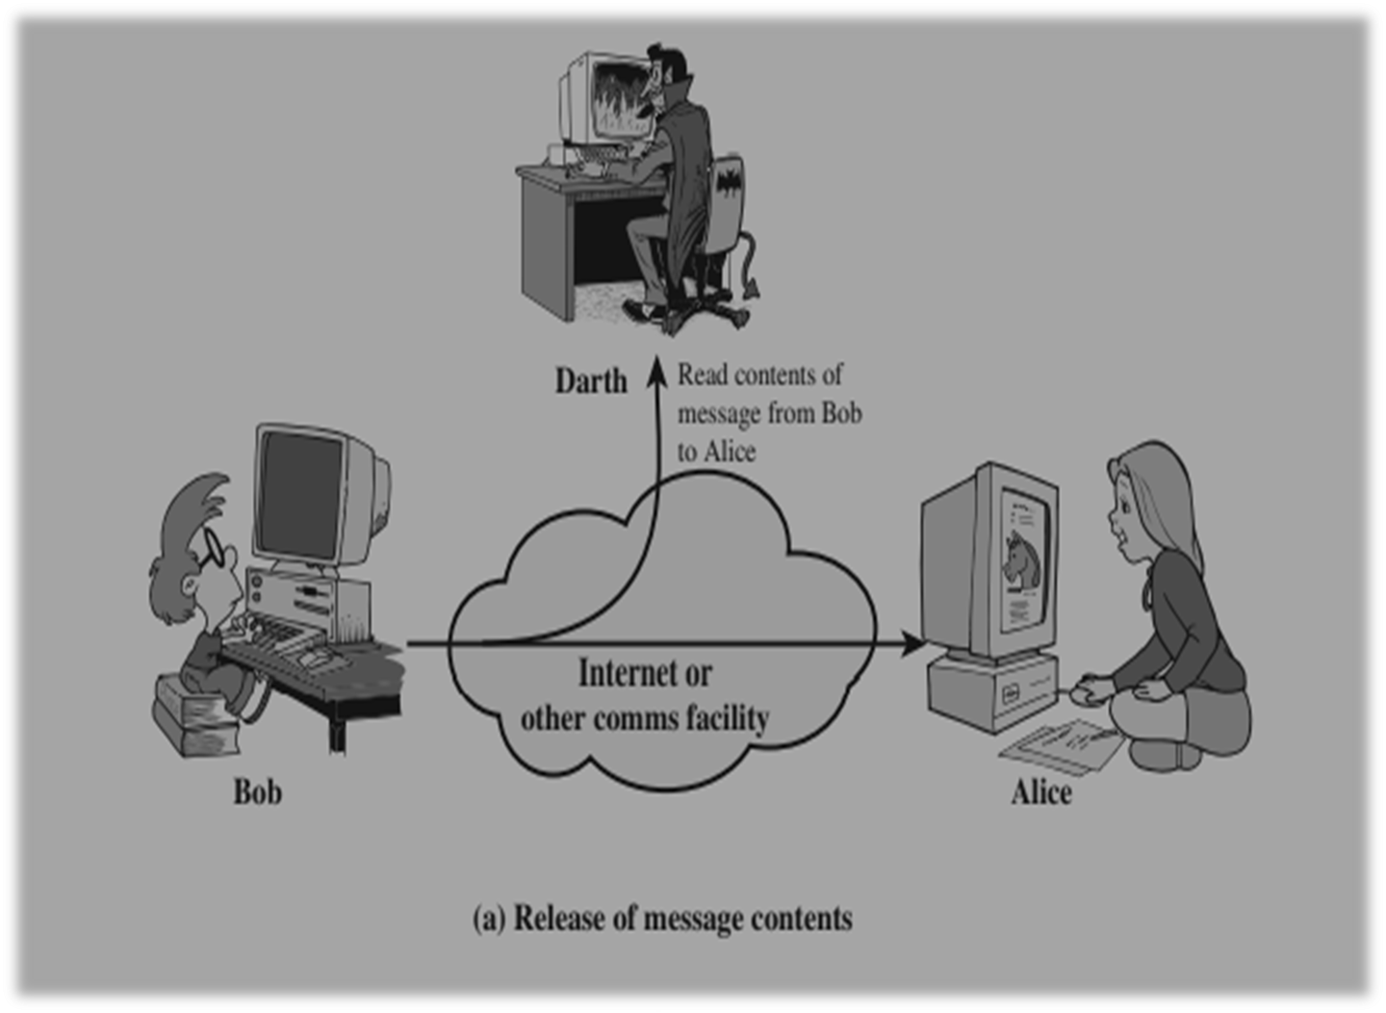

Slide 29
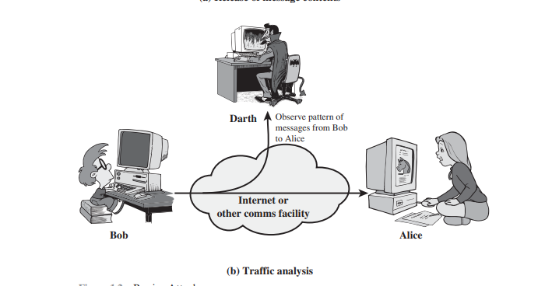

Slide 30

Active Attacks

Slide 31
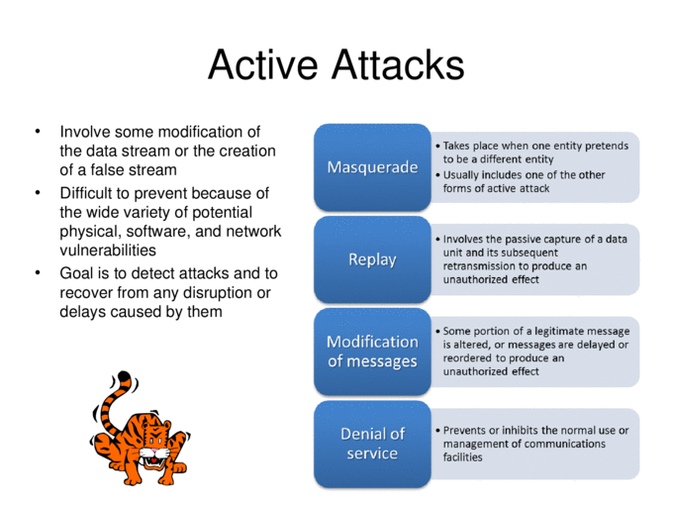

Slide 32
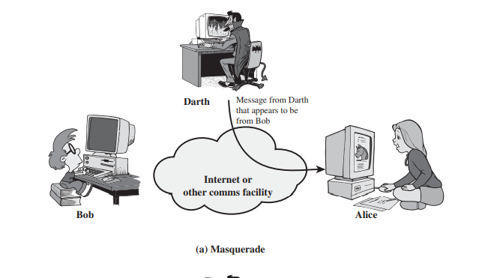

Slide 33
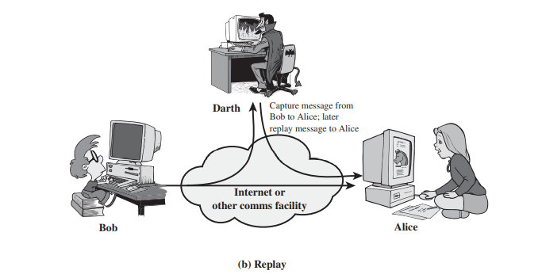

Slide 34
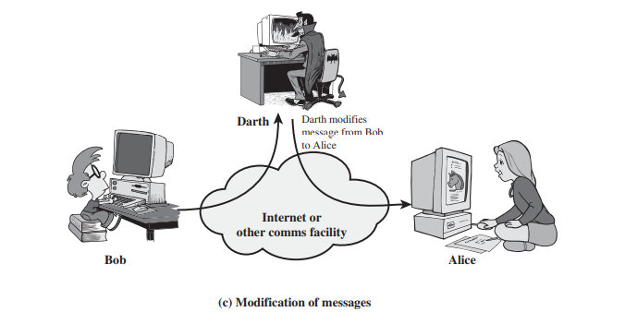

Slide 35
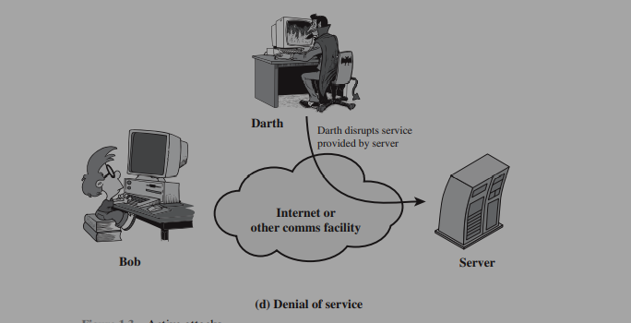

Slide 36
Security Service
  enhance security of data processing systems and information transfers of an organization
  intended to counter security attacks
  using one or more security mechanisms
  often replicates functions normally associated with physical documents
    which, for example, have signatures, dates; need protection from disclosure, tampering, or destruction; be notarized or witnessed; be recorded or licensed

Slide 37
Security Services (X.800)
Authentication - assurance that the communicating entity is the one claimed
Access Control - prevention of the unauthorized use of a resource
Data Confidentiality –protection of data from unauthorized disclosure
Data Integrity - assurance that data received is as sent by an authorized entity
Non-Repudiation - protection against denial by one of the parties in a communication

Slide 38
Security Mechanism
feature designed to detect, prevent, or recover from a security attack
no single mechanism that will support all services required
however one particular element underlies many of the security mechanisms in use:
  cryptographic techniques
hence our focus on this topic

Slide 39
Security Mechanisms (X.800)
specific security mechanisms:
  encipherment, digital signatures, access controls, data integrity, authentication exchange, traffic padding, routing control, notarization
pervasive security mechanisms:
  trusted functionality, security labels, event detection, security audit trails, security recovery

Slide 40

Model for Network Security

Slide 41
Model for Network Security
using this model requires us to:
  design a suitable algorithm for the security transformation
  generate the secret information (keys) used by the algorithm
  develop methods to distribute and share the secret information
  specify a protocol enabling the principals to use the transformation and secret information for a security service

Slide 42

Model for Network Access Security

Slide 43
Model for Network Access Security
using this model requires us to:
  select appropriate gatekeeper functions to identify users
  implement security controls to ensure only authorised users access designated information or resources
trusted computer systems may be useful to help implement this model

Slide 44
Thank You

